Slide 1

Clean Code
Agile Software Craftmanship
By Vinanti Thakur
(Tech. Architect)
January 2, 2020

Slide 2
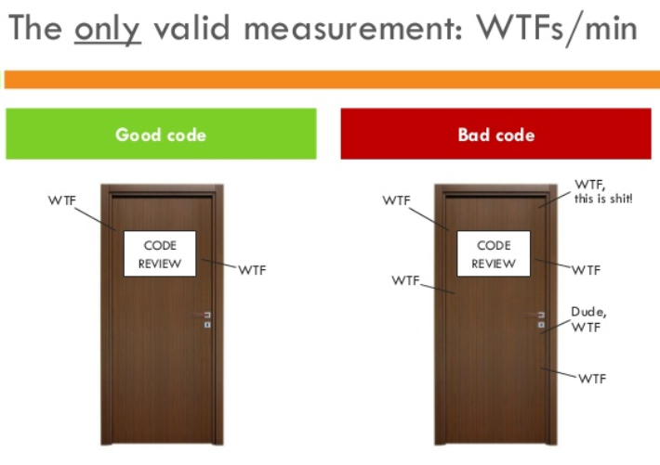
Introduction
Writing clean code is what you must do in order to call yourself a professional. There is no reasonable excuse for doing anything less than your best.
Clean code is subjective and every developer has a personal take on it.
There are some ideas that are considered best practice and what constitutes as clean code.
2 January 2020

Slide 3
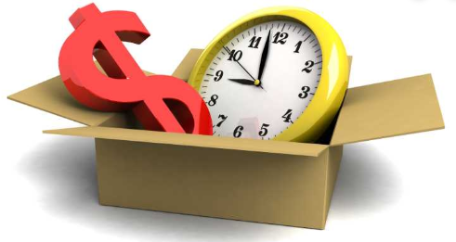
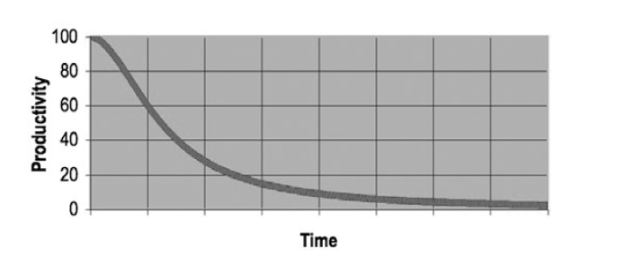
Why Clean Code..??
Reason 1: you are a Programmer.
Reason 2: you want to be a Better Programmer.
The Total cost if Owning a Mess!
2 January 2020

Slide 4
Goal: Code must be…
Readable
Maintainable
Extendable
Testable
2 January 2020

Slide 5
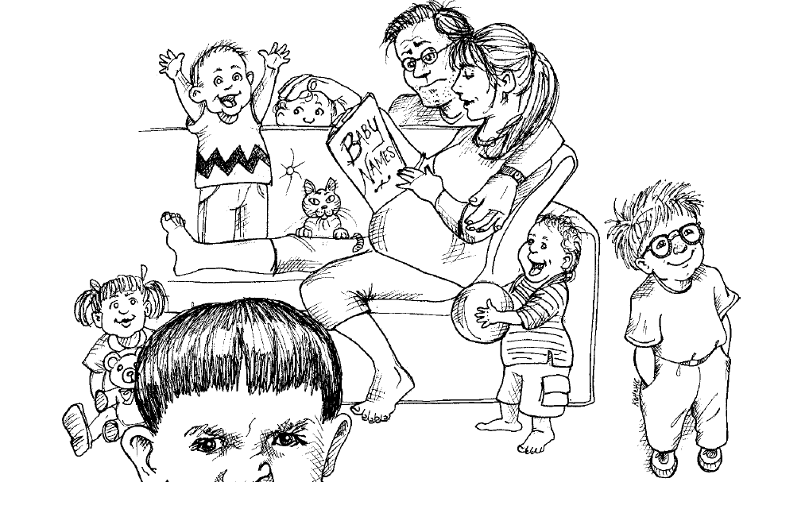
Meaningful Name
Naming Convention is an important in Architecture Modeling.
A naming convention is a set of rules for choosing the names which denote variables, types, functions, and other entities in your code.
Standard naming system must be define in Architectural/coding Document and set as standard.
2 January 2020

Slide 6


Meaningful Name
1. Use Intention- Revealing Name:
int d; //elapsed time in days
Int elapsedTimeInDays;
2 January 2020

Slide 7
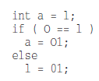
Meaningful Name
2. Avoid Disinformation:
2 January 2020

Slide 8

Meaningful Name
3. Make Meaningful Distinctions:
2 January 2020

Slide 9


Meaningful Name
4. Use Pronounceable Names:
2 January 2020

Slide 10
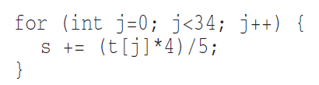
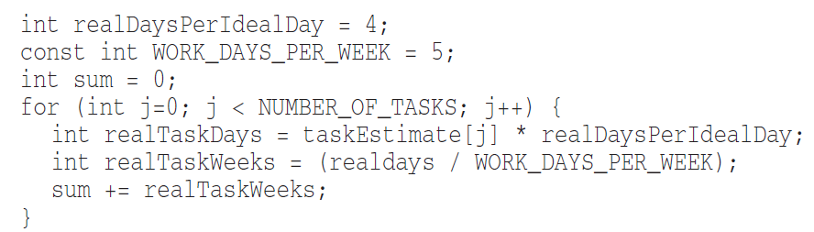
Meaningful Name
5. Use Searchable Names:
2 January 2020

Slide 11
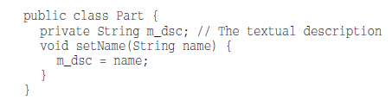
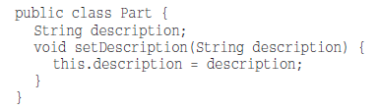
Meaningful Name
6. Avoid Encoding:
2 January 2020

Slide 12


Meaningful Name
7. Avoid Mental Mapping:
2 January 2020

Slide 13




Meaningful Name
8. Class Names:
9. Method names:
2 January 2020

Slide 14
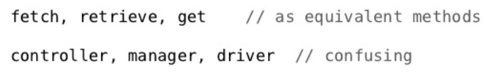
Meaningful Name
10. Pick One Word per Concept:
2 January 2020

Slide 15

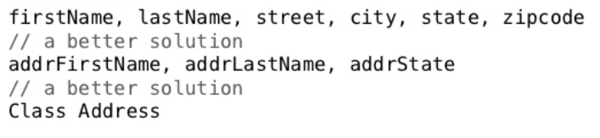
Meaningful Name
11. Use Solution Domain Names:
12. Add Meaningful Context:
2 January 2020

Slide 16
Functions
Functions are the first line of organization in any program.
2 January 2020

Slide 17
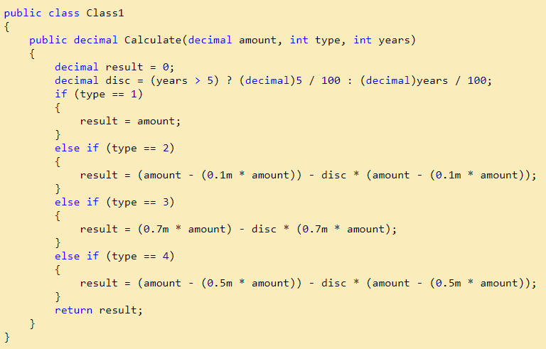
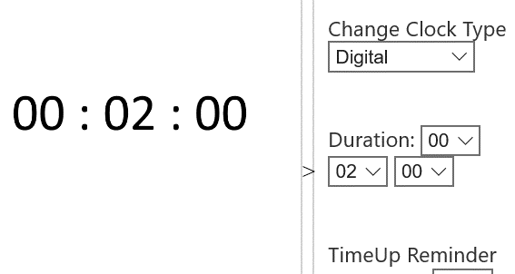
Functions
2 January 2020

Slide 18
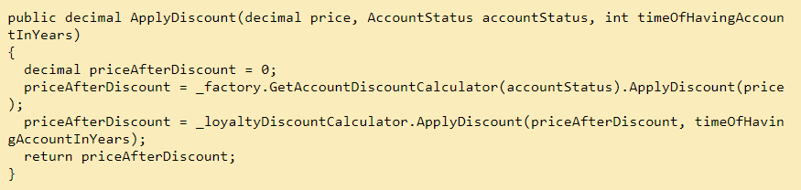
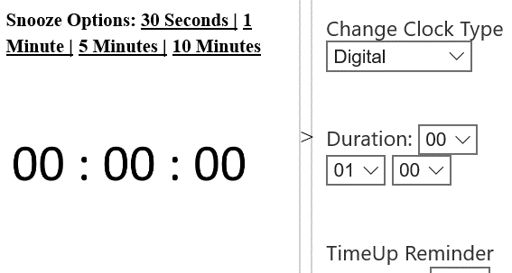
Functions
2 January 2020

Slide 19
Functions
2 January 2020

Slide 20
Functions
Small!
Rules of writing functions()
Should be small
Should be smaller than small
Define rules in organization
< 150 characters / line
< 20 lines
Do One Thing
FUNCTIONS SHOULD DO ONE THING.
THEY SHOULD DO IT WELL.
THEY SHOULD DO IT ONLY.
2 January 2020

Slide 21
Functions
One Level of Abstraction per Function
a very high level of abstraction
getHtml();
an intermediate level of abstraction
String pagePathName = PathParser.render(pagePath);
low level of abstraction
.append("\n")
Mixing levels of abstraction within a function is always confusing.
The Stepdown Rule
Reading Code from Top to Bottom
2 January 2020

Slide 22
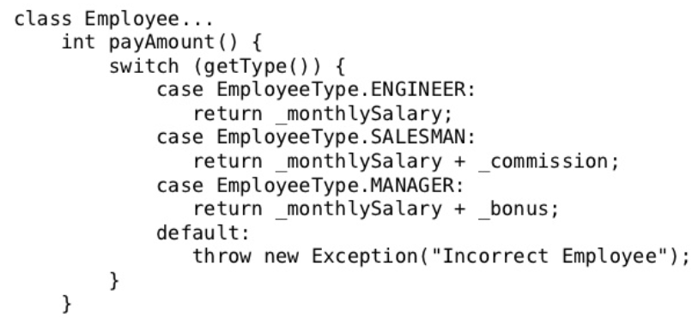
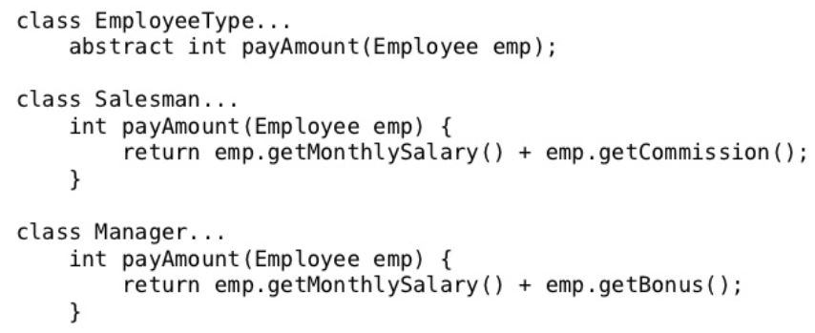
Functions
Switch Statements
By their nature, switch statements always do N things. Unfortunately
we can’t always avoid switch statements, but we can make sure that each switch
statement is buried in a low-level class and is never repeated by using Polymorphism.
2 January 2020

Slide 23
Functions
Use Descriptive Names
Don’t be afraid to make a name long. A long descriptive name is better than a short
enigmatic name.
A long descriptive name is better than a long descriptive comment.
Function Arguments
The ideal number of arguments for a function is zero (niladic).
Next comes one (monadic),
Followed closely by two (dyadic)
Three arguments (triadic) should be avoided where possible.
More than three (polyadic) requires very special justification and then shouldn’t be used anyway.
2 January 2020

Slide 24
Functions
Common Monadic Forms
There are two very common reasons to pass a single argument into a function.
You may be asking a question about that argument, as in boolean fileExists(“MyFile”).
you may be operating on that argument, transforming it into something else and returning it. For example, InputStream fileOpen(“MyFile”)
Flag Arguments
Flag arguments are ugly.
Passing a Boolean into a function is a truly terrible practice.
complicates the signature of the method – do one thing
It does one thing if the flag is true and another if the flag is false!
2 January 2020

Slide 25
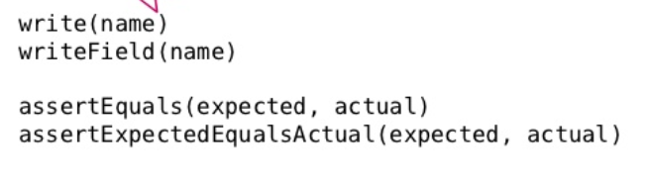
Functions
Argument Objects – Wrapping aurguments
Circle makeCircle(double x, double y, double radius);
Circle makeCircle(Point center, double radius);
Verbs and Keywords
2 January 2020

Slide 26
Functions
Have No Side Effects
2 January 2020

Slide 27
Functions
Output Arguments
2 January 2020

Slide 28
Functions
Command Query Separation
2 January 2020

Slide 29
Functions
Prefer Exceptions to Returning Error Codes
2 January 2020

Slide 30
Functions
Extract Try/Catch Blocks
2 January 2020

Slide 31
Functions
Error Handling Is One Thing
2 January 2020

Slide 32
Functions
The Error.java Dependency Magnet
2 January 2020

Slide 33
Functions
Don’t Repeat Yourself
2 January 2020

Slide 34
Functions
Structured Programming
2 January 2020

Slide 35
Functions
How Do You Write Functions Like This?
2 January 2020

Slide 36
Comments
Mumbling
2 January 2020

Slide 37
Comments
Redundant Comments
2 January 2020

Slide 38
Comments
Misleading Comments
2 January 2020

Slide 39
Comments
Mandated Comments
2 January 2020

Slide 40
Comments
Journal Comments
2 January 2020

Slide 41
Comments
Noise Comments
2 January 2020

Slide 42
Comments
Scary Noise
2 January 2020

Slide 43
Comments
Don’t Use a Comment When You Can Use a Function or a Variable
2 January 2020

Slide 44
Comments
Position Markers
2 January 2020

Slide 45
Comments
Closing Brace Comments
2 January 2020

Slide 46
Comments
Attributions and Bylines
2 January 2020

Slide 47
Comments
Commented-Out Code
2 January 2020

Slide 48
Comments
HTML Comments
2 January 2020

Slide 49
Comments
Nonlocal Information
2 January 2020

Slide 50
Comments
Too Much Information
2 January 2020

Slide 51
Comments
Inobvious Connection
2 January 2020

Slide 52
Comments
Function Headers
2 January 2020

Slide 53
Comments
Javadocs in Nonpublic Code
2 January 2020

Slide 54
Formatting
2 January 2020

Slide 55
Object and data structure
2 January 2020

Slide 56
Error Handling
2 January 2020

Slide 57
Boundaries
2 January 2020

Slide 58
Unit Test
2 January 2020

Slide 59
Classes
2 January 2020

Slide 60
Systems
2 January 2020

Slide 61
Emergence
2 January 2020

Slide 62
Concurrency
2 January 2020

Slide 63

Thank You!!!
2 January 2020

